Slide 1
CHSP Narrative Report Preparation & Submission

Slide 2
Quarterly/Year-End Report | Reporting Period | Report Submission Deadline
First Quarter | October 1st through December 31st | January 25th
Second Quarter | January 1st through March 31st | April 25th
Third Quarter | April 1st through June 30th | July 25th
Year-End Report | October 1st through September 30th | October 31st

Slide 3
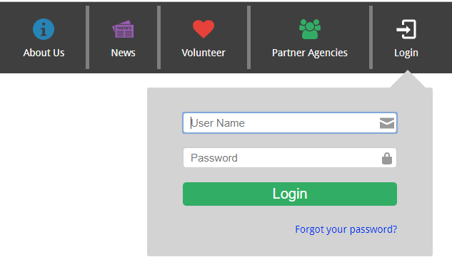
Login Information
Log into your account at: https://chspportal.org
If you forgot your password
Click on forgot your password?
Follow directions to log in

Slide 4
Click on the Q Report icon (4th icon) Click on Start Report (black button)
How to Start a Report

Slide 5
How to Start a Report
From the dropdown options
Select the correct Funding Year
Select your CHSP Team
Enter your Program Name as listed in your contract
Select the Reporting Period
Click Next

Slide 6
You will see each section and subsection of the report if you click on the vertical navigation bar on the right side of your screen; this bar expands and contracts as you click on it. A green checkmark on the subsections means that you completed this portion of the report.
Progress Navigation

Slide 7
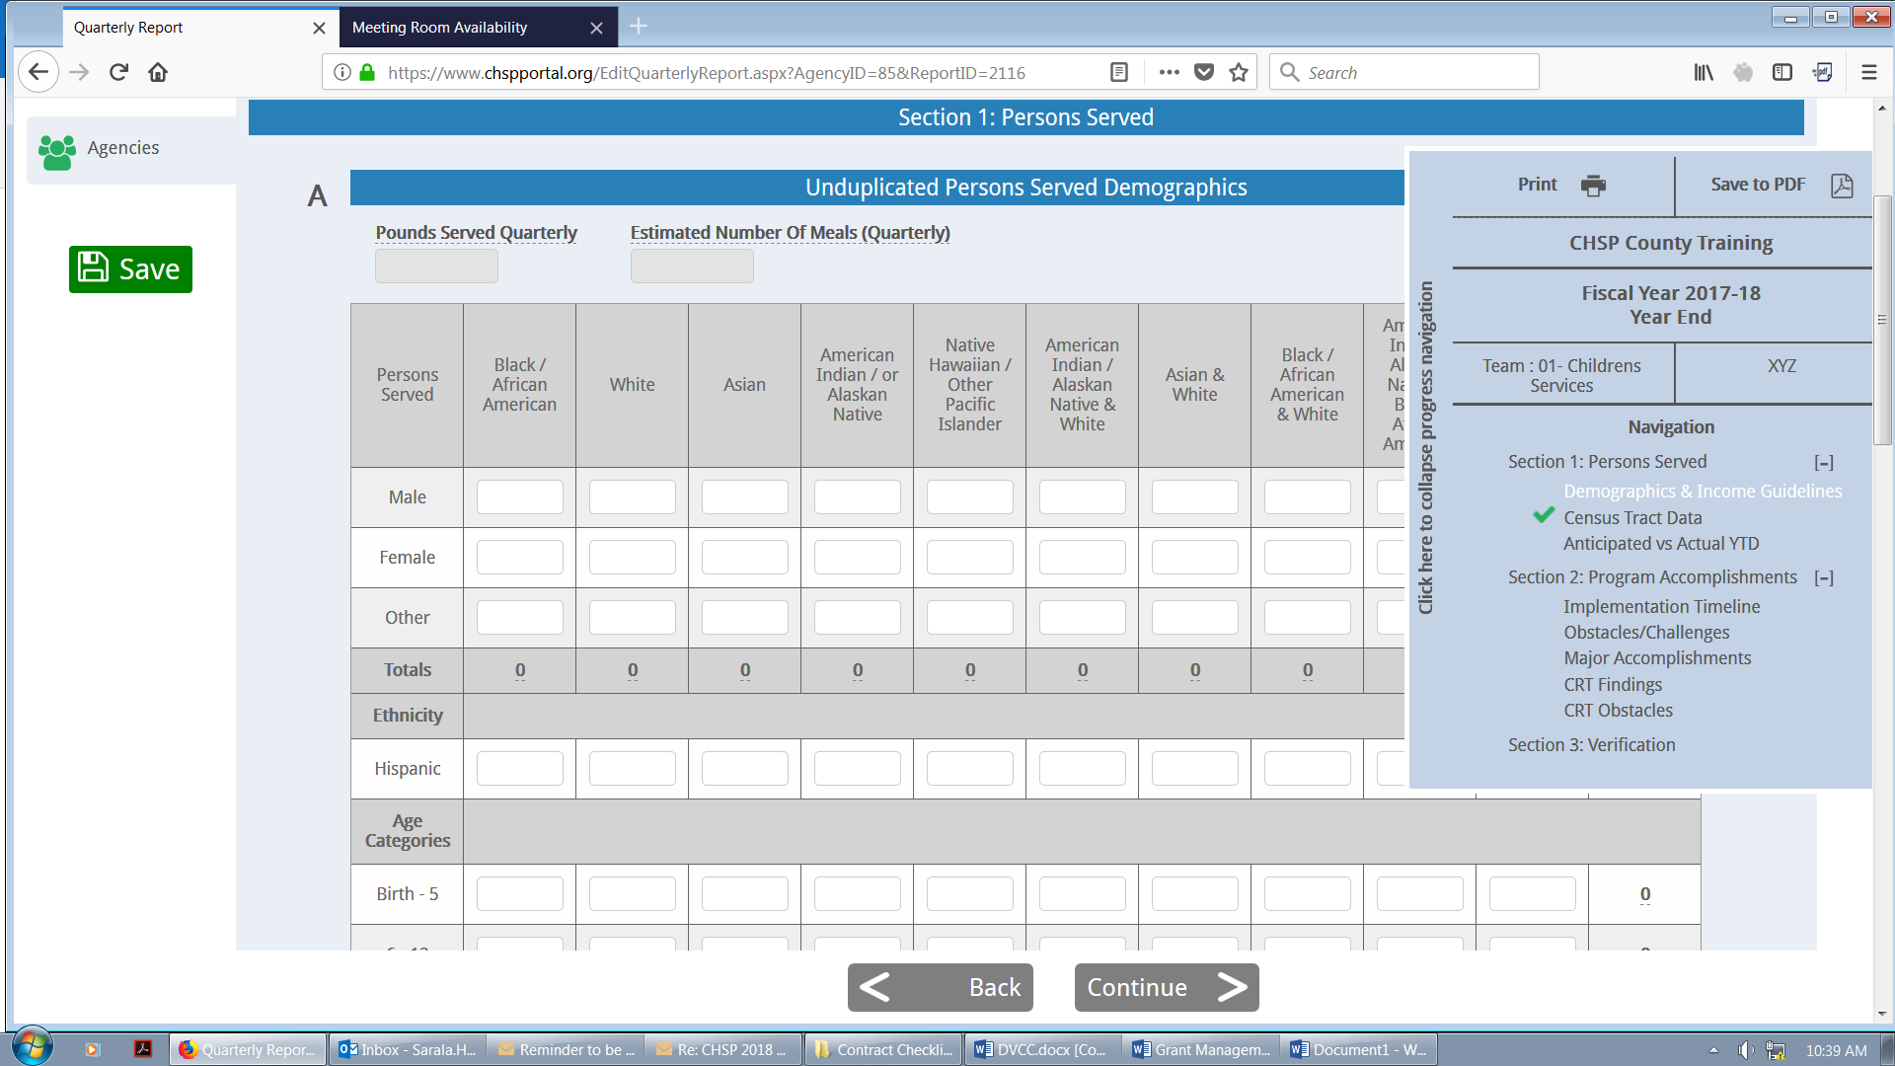
Section 1: Persons Served A and B: Demographics & Income Guidelines
Complete appropriate fields and click Continue. Please note that this section requires you to provide unduplicated (new clients) numbers served during the reporting period only; all subsection totals must match, except for the number of Hispanic persons served.
Click Save as needed and Continue

Slide 8
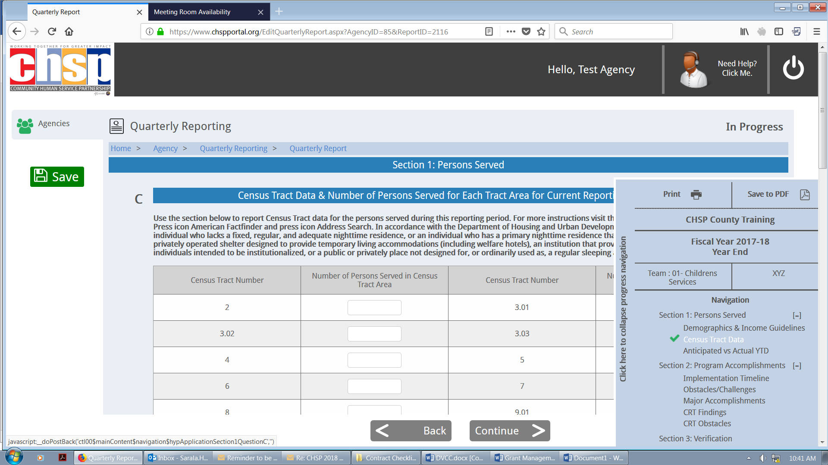
Section 1: Persons Served C: Census Tract Data
Complete this section only if your program receives Promise Zone (Team 10) funding. The total number you report here should match the total unduplicated number you listed in the previous Section 1: Persons Served A: Demographics
Click Save and Continue

Slide 9
Section 1: Persons Served D: Anticipated vs. Actual YTD
The number entered for Anticipated Number of Persons to be Served as Stated in the Contract, Attachment A, should be the exact number listed in the Contract. Refer to your contact: Question C3 (or C2 for Promise Zone Contracts)
The Cumulative Number of Unduplicated Persons Served To-Date should reflect the total number of unduplicated clients served since October 1^{st.}
Click Save as needed and Continue

Slide 10
Section 2: Program Accomplishments A and A2: Implementation Timeline

Slide 11
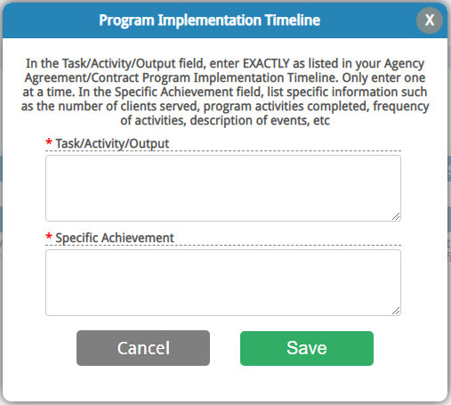
Section 2: Program Accomplishments A: Program Implementation Timeline
The Task/Activity/Output field should be the exact language from the Program Implementation Timeline chart in the contract.
The Specific Achievement field should list specific information such as the number of clients served, program activities completed, frequency of activities, description of events, dates if applicable, etc.
Click Save
Note: Refer to your contract to ensure you are reporting on the exact deliverables listed in your contact.

Slide 12
Section 2: Program Accomplishments A2: Outcome Measurement Framework
Note: Only made available in the Year-End report.
The Program Outcome field should be the exact language from Attachment C: Program Logic Model/Outcome Measurement Framework Program Outcome chart in the contract.
The Measurable Indicators field should be the exact language from Attachment C: Program Logic Model/Outcome Measurement Framework Measurable Indicators chart in the contract.
The Specific Achievement field should precisely describe the program accomplishments, including numbers and correlating percentages.
Click Save and Continue
Note: Refer to your contract to ensure you are reporting on the exact deliverables listed in your contact.

Slide 13
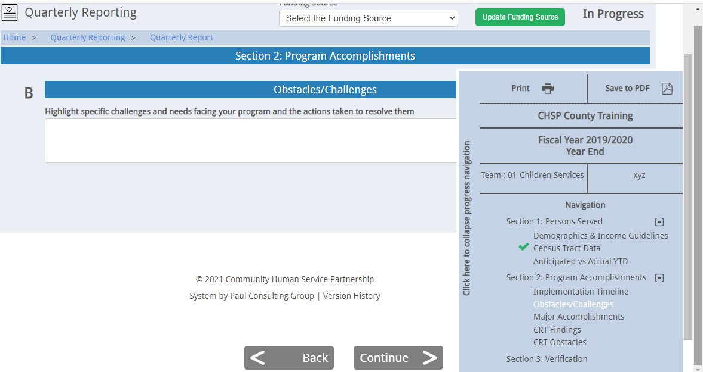
Section 2: Program Accomplishments B: Obstacles/Challenges
Highlight specific challenges and needs facing your program and the actions taken to resolve them
Click Continue

Slide 14
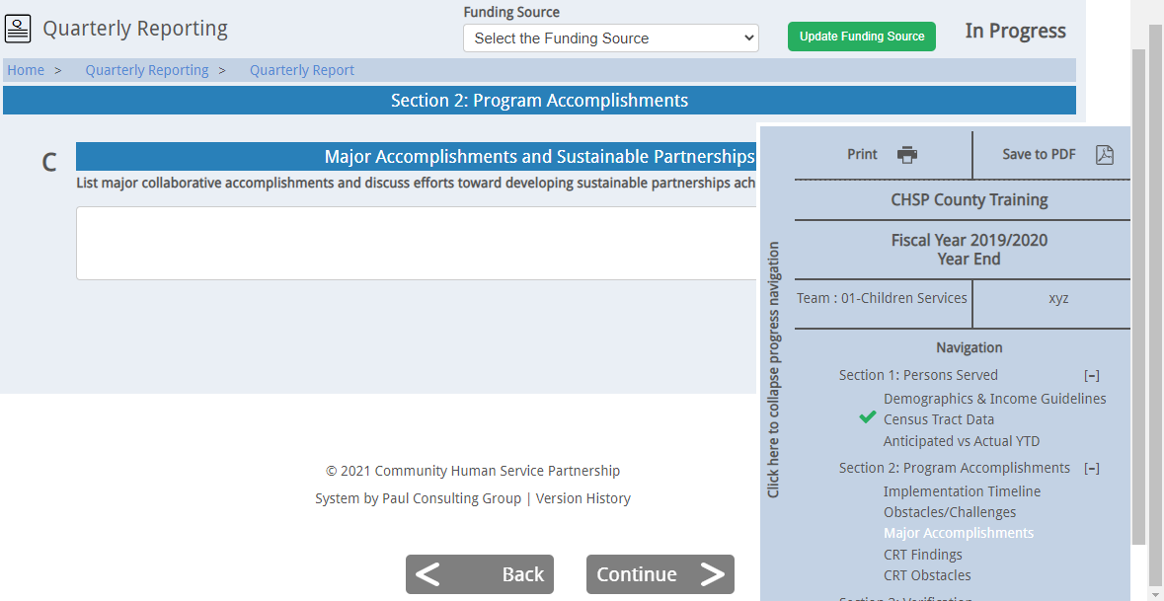
Section 2: Program Accomplishments C: Major Accomplishments
List major collaborative accomplishments and discuss efforts toward developing sustainable partnerships achieved during this reporting period.
Click Continue

Slide 15
Section 2: Program Accomplishments D: Citizens Review Team Findings and E: CRT Obstacles
Section D: Refer to your contract. If there are any Citizens Review Team Findings listed in your contract, please enter the exact language, and provide an update on measures taken to resolve the concerns. If no concerns are noted in your contract, click the box The Agency does not have a CRT finding or Serious Concern for this reporting period.
Section E: Discuss any significant obstacles encountered in the resolving CRT findings or concerns
Click Save and Continue

Slide 16
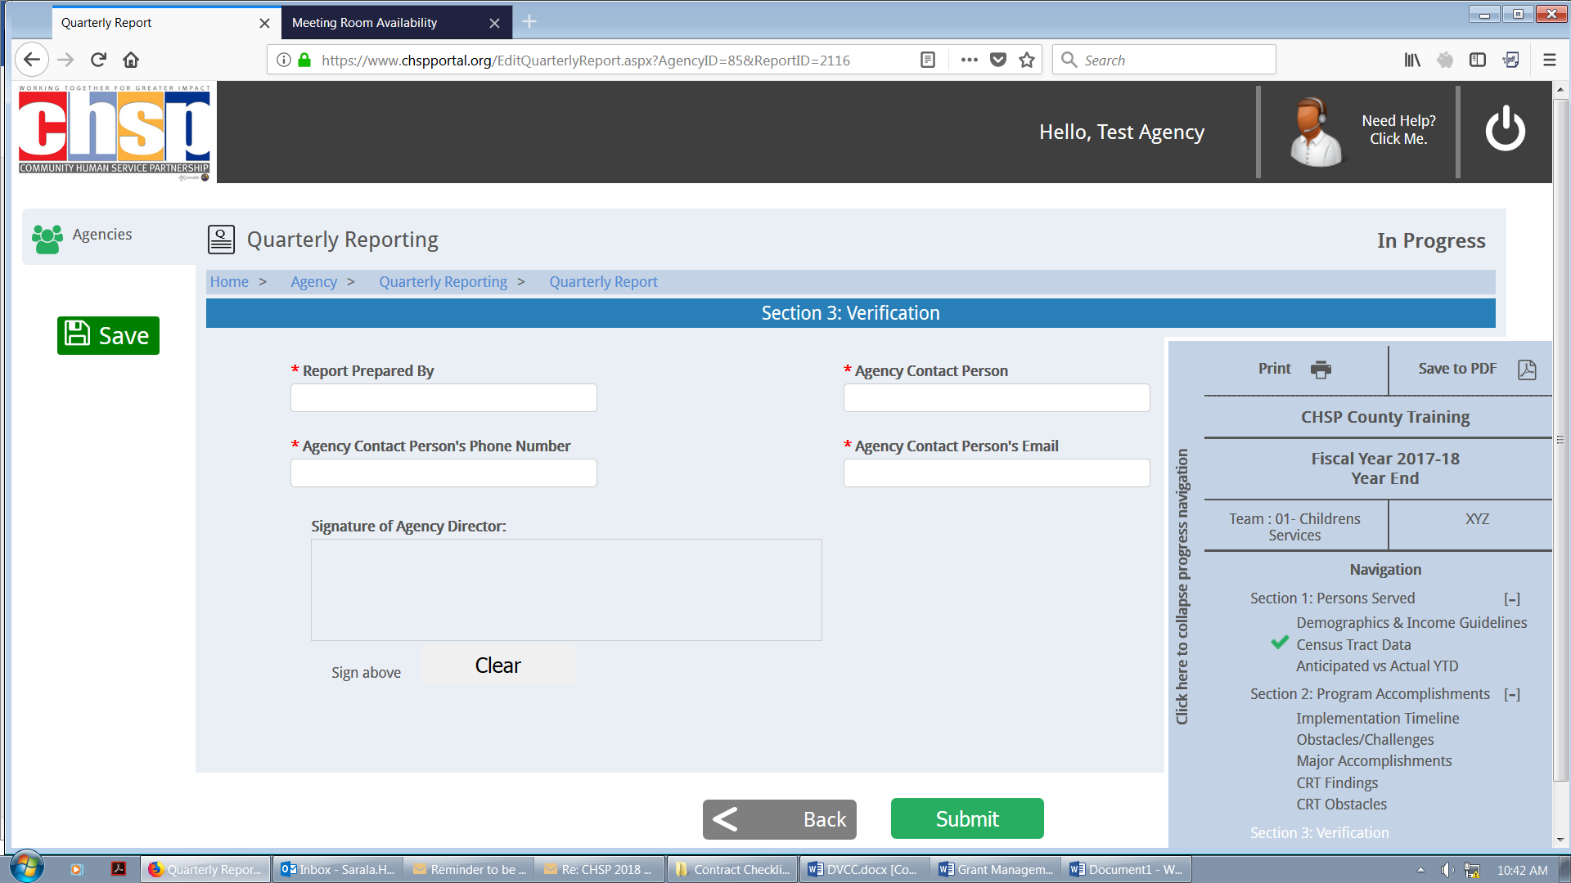
Section 3: Verification
Complete all fields, sign click Save and Submit
It is important that all parties who need to sign off on Applications and/or Reports are registered in the CHSP Portal. Please reach out to your Contract Manager for further assistance, if applicable.

Slide 17
Questions?

